Slide 1
Kmart Apparel Open Source
Scrum Process

Slide 2
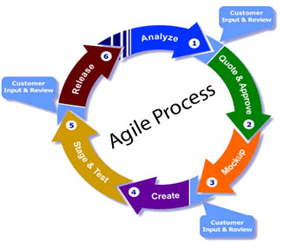
Scrum Process
Process Stages:
Analyze/ Requirement Gathering – Review backlog user stories
Quote & Approve – Estimate Sprint and provide quote to Kmart BU
Mockup – Creative team creates mockup of new features
Create – Open Source Development team will update code
Stage & Test – Development provides staging link for team to review and QA tests new features
Release – Push new features into production

Slide 3
Kmart Apparel Backlog
Backlog is an ordered list of “requirements”
Client will determine business value, dependencies, and date needed
Requirements added will be in story format (user stories)
Contains rough estimates of both business value and management effort (ROI)
Sprint is a time period in which a set of backlog items are completed

Slide 4
Kmart Apparel User Stories
Client defines the needs of the customer
As a (user role) I need to have (functionality) that provides (value)
Client defines the priority
High, Med, Low
Some stories have dependencies:
X and Y must be implemented at the same time
X must precede Y, or else we cannot implement Y

Slide 5
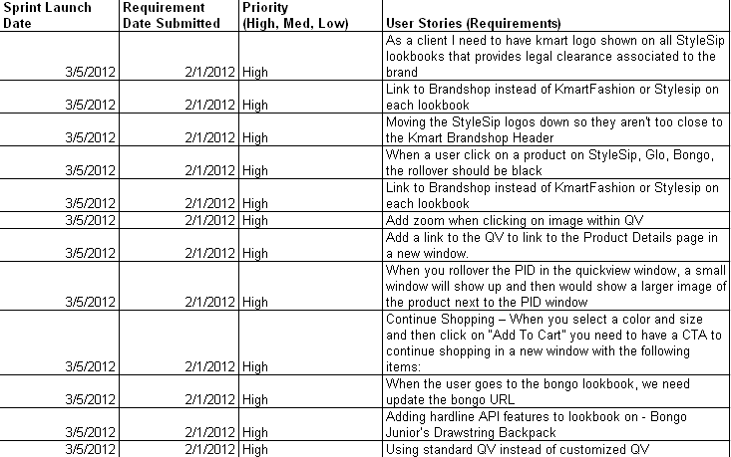
Kmart Apparel Backlog Example
Located at: https://docs.google.com/spreadsheet/ccc?key=0Ao1_SrSXpZ6ldG1zX085bHZ6ZlV0T0xjYURQZmpydkE#gid=0

Slide 6
Week 1
Week 2
Week 3
M
T
W
R
F
M
T
W
R
F
M
T
W
R
F
Estimates
Receive
Requirements
Start Work
Code Freeze
Week 4
Week 5
Week 6
M
R
M
T
W
R
F
M
T
W
M
T
T
W
F
W
R
F
Code Push
QA Bug Fixes
Any requirements/features handed off for estimation after 12:00 P.M. Wednesday will be included in the next development life cycle (three weeks later).

